Slide 1
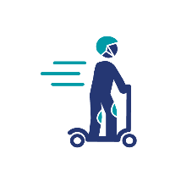
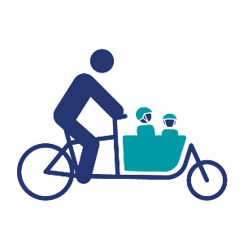
OnePath BS5: Pattern and Place
Help us to create patterns and path features
that represent your local area
on the Bristol & Bath Railway Path.

Slide 2
Introduction – page for teachers/ parents
In light of the recent developments with Covid-19, meaning we are limited to visiting schools and delivering assemblies in person, I have set up this PowerPoint as a self-serve resource for schools and parents.
What to do: run through the PowerPoint with your children to introduce the Pattern and Place project. Inform them of the deadline for submitting their contributions (Sustrans deadline: 5pm on Friday 18 September 2020). Presenter notes are included on some pages – use them to help explain the respective sections.
What to expect: Sustrans will aim to collate all contributions from the children electronically via email by the deadline at the end of summer term. Please email all contributions, in the form of image and text based content, to han.brittain@Sustrans.org.uk. Please include details of your child’s school name and class, so we can organise your contributions by school and age groups. Sustrans will use these contributions to inform designs for patterns and signage on the path, with potential to inform artwork, gateway features and digital materials that will go online about the path & local identity. Subject to mitigating circumstances, we may be able to come back to work with pupils on the next stage in person, or alternatively, we can continue communication remotely.
Please delete this page from the PowerPoint before presenting it. Thanks!
OnePath Pattern and Place Project | 28 July 2020

Slide 3
Contents
Sustrans – a little introduction! Who we are, our vision and mission.
Bristol and Bath Railway Path – brief history & video
OnePath BS5 Project – improving Bristol Bath Railway Path for everyone
Pattern and Place Challenge – how you can help!
OnePath Pattern and Place Project | 28 July 2020

Slide 4
1. Sustrans
A little introduction!
We are a charity that works Nationwide, across England, Wales, Scotland and Northern Ireland, but our Headquarters are right here in Bristol!
The word “Sustrans” combines “Sustainability” and “Transport”.

Slide 5
Sustrans mission
We make it easier for people to walk and cycle
OnePath Pattern and Place Project | 28 July 2020

Slide 6
Sustrans vision
OnePath Pattern and Place Project | 28 July 2020

Slide 7
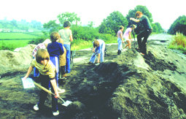
2. Bristol and Bath Railway Path
A brief history & video
OnePath Pattern and Place Project | 28 July 2020
Notes:
Brief history – the path was built on an old railway line – Midland Railway – in 1979 (photo showing volunteers digging up the ground to make way for the path).
Photo to the right: Last year (2019), the Railway Path turned 40 years old and we had a big birthday party to celebrate!

Slide 8
Movie time! (wait a few seconds, then press play)
2 minute video about the creation of Sustrans (then ‘Cyclebag’) and the Bristol and Bath Railway Path
Notes:
Video explaining the roots of Sustrans (when it used to be called Cyclebag!) and the creation of our first ever traffic free cycle path on the National Cycle Network – the Bristol and Bath Railway Path

Slide 9
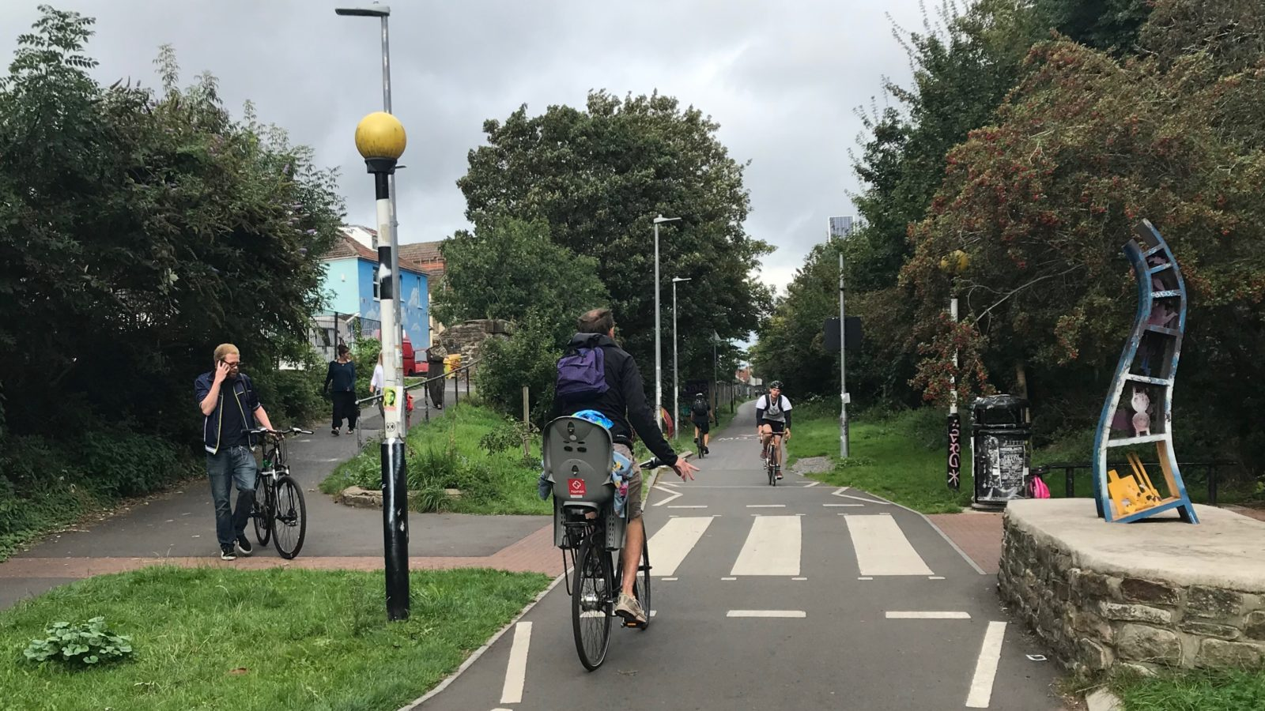
Here is what the Railway Path looks like today. This photo shows the zebra crossing at Whitehall.
The traffic-free path is very popular, and loved by many people who use it to walk, cycle, scoot or wheel, away from the traffic on the roads.
BUT parts of the path can get very busy at certain times of the day, and for some groups of people, the path does not always feel inviting or easy to use.
We want to address these issues and make the path better for everyone, with YOUR HELP!
OnePath Pattern and Place Project | 28 July 2020

Slide 10
3.
OnePath: BS5 project
Improving the Bristol and Bath Railway Path for everyone.
In partnership with Bristol City Council.
OnePath Pattern and Place Project | 28 July 2020
Notes:
This brings us to the OnePath BS5 project.
Working with Bristol City Council, the OnePath: BS5 project seeks to build on the success of the Bristol and Bath Railway Path, while addressing issues that sometimes arise on one of its busiest stretches.

Slide 11
Community Vision for the Railway Path
The basis for the OnePath BS5 project …
“We are committed to a Bristol and Bath Railway Path that is a safe space: a park, path and place for all users, by foot or by wheel, enabling healthy lifestyles in a green and biodiverse corridor linking the two cities and communities across the West of England Combined Authority.
We will work with all of the communities who use the Bristol and Bath Railway Path to redesign and reshape it so that its value to people, wildlife, its localities and the region as a whole is enhanced and protected for generations to come.”
OnePath Pattern and Place Project | 28 July 2020
Notes:
This community vision for this project sets the basis for the OnePath BS5 funded project and acts as a shared point of reference as the project moves forward.
The main point to take away from this vision is that the path is, or should be, for EVERYONE. Whether you are young, old, disabled, able-bodied, on a bike, on foot or otherwise, we want you to be able to enjoy the path.

Slide 12
We have held a series of workshops with the local community in Bristol BS5, with people who live near the path, use the path, or would like to.
This picture graphic shows what people have told us they want from the Railway Path.
To make sure we give the Railway Path the best redesign possible;
We need your help!
In particular, with the four circled points.
OnePath Pattern and Place Project | 28 July 2020

Slide 13
More chances to move slowly
Going slowly means time to enjoy yourself and your surroundings! At present, lots of people have told us there is pressure to go fast on the path and would like the opportunity to use it at a more relaxing pace and in in different ways. We plan to introduce patterns on the path, with your input, to encourage a culture of slowing down to enjoy the space.
Give everyone more reasons to enjoy it:
We want your help to make the path look inviting and be more enjoyable to use. Not all disabilities or impairments can be seen but we know the path can be particularly tough or uninviting for groups with mobility differences, for example. We know the path can offer so much more, from opportunities to play, discover artworks and wildlife and spend time with friends.
Reflect local neighbourhood identities:
We have heard from many community members who want more of a sense of place on the path. We aim to reflect local neighbourhood identities through welcome signs, artwork and patterns.
More artworks; tactile nature trails; kiosks:
The community have also told us that they want more from the path, not just an A-to-B cycling route. We hope you can help us with the artwork element!
We have held a series of workshops with the local community in Bristol BS5, with people who live near the path, use the path, or would like to.
This picture graphic shows what people have told us they want from the Railway Path.
To make sure we give the Railway Path the best redesign possible;
We need your help!
In particular, with the four circled points.
OnePath Pattern and Place Project | 28 July 2020

Slide 14
4.
What makes your local area special?
We want to know what you love and what’s important to you about your local area; the place where you live, play with friends, go to school, take part in sports, walk, scoot, cycle and everything in-between.
To do this, we are asking you to take part in our ‘Pattern and Place Project’.
OnePath Pattern and Place Project | 28 July 2020

Slide 15
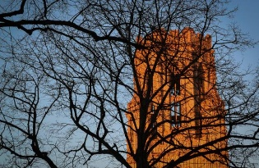
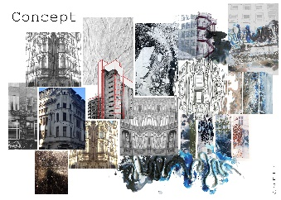
Pattern and Place Project
Share something that reflects your local area to you.
This could be something you create, or something you already own.
For example…
A picture or piece or art
A story, memory or description
A prized item e.g. a favourite football
A photo of something in the local area
A mood board
OnePath Pattern and Place Project | 28 July 2020
Notes:
Homework! Share something that tells a story about your local area.

Slide 16
Your contributions:
Please email your Pattern and Place contributions to Sustrans by the end of summer term: 5pm Friday 18 September 2020. Include your school name and class!
Sustrans contact: Han Brittain, Sustrans South Officer
Email: han.brittain@Sustrans.org.uk Phone: 07920 182 154
Your contributions will help inform:
Designs for patterns and signage on the path
Options also for artwork, gateway features and digital materials to go the website about the path & local identity.
OnePath Pattern and Place Project | 28 July 2020

