Slide 1

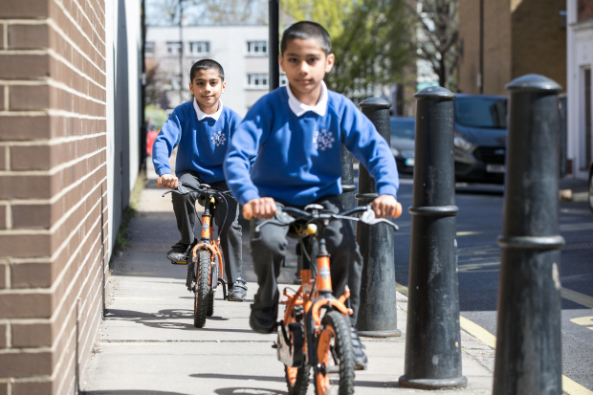
How common is my journey to school?
©2021, Kois Miah, all rights reserved

Slide 2


You are 1 of 10 million
school children in the UK
9 million in England, 500,000 in Wales,
700,000 in Scotland, 300,000 in Northern Ireland

Slide 3


How do you travel?
1, 2, 4, 11, 37, 43
Cycle | Car / Van | Local bus | Private bus | Train | Walk
Notes:
Figures showing what percentage of UK children travel to school using this mode of transport. Prompt pupils to guess which figure matches with each mode of transport.

Slide 4
How do you travel?
Answers
Cycle | Car / Van | Local bus | Private bus | Train | Walk
2 | 37 | 11 | 4 | 1 | 43
Notes:
Data is sourced from: https://www.ethnicity-facts-figures.service.gov.uk/culture-and-community/transport/travel-to-school/latest

Slide 5
Questions
Why do you think most people travel like this to school?
What’s stopping people from cycling to school?
What do you think the %’s are for your class or school?

Slide 6
How long does it take?
My journey time (mins) | Friend 1 | Friend 2 | Friend 3 | Friend 4 | Friend 5 | Friend 6 | Average
Calculate the average for you and 6 friends. How does you average compare to the national average of 19 minutes?

Slide 7
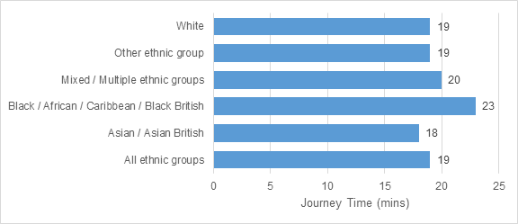
How long does it take?
Extension 1
Why might journey times vary for different ethnic groups?

Slide 8

How far do you travel?
Extension 2
Average = 2.4 miles (3.9km) to school
How far can you get from your school in a 10 minute walk or cycle?
Notes:
Pupils can use https://app.traveltime.com/ to see how far they could get from school in a 10 minute walk or cycle

Slide 9
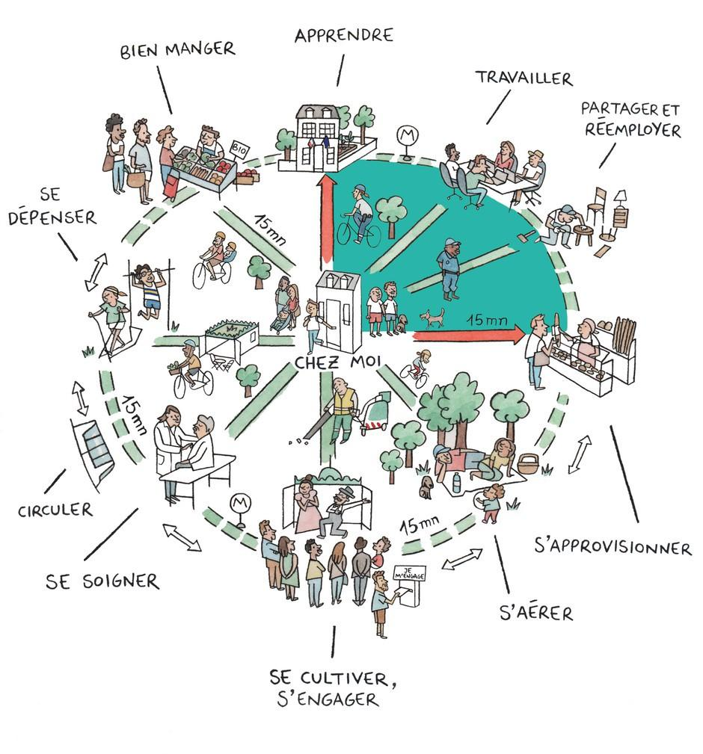

15 minute neighbourhoods
Extension 3

Slide 10
Extension 3
Could your local area be a 15 minute neighbourhood?
What’s stopping it?
Notes:
Show pupils this video on 15 minute neighbourhoods: https://youtu.be/McGyONofhi4

