Slide 1




Clean Air Schools
BCP Infant, Junior + Primary Schools

Slide 2




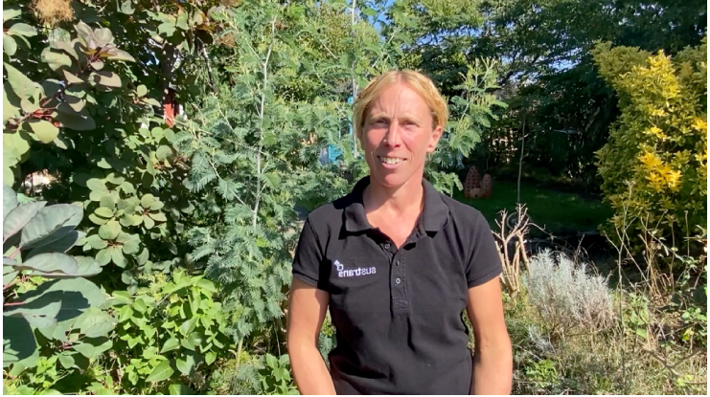
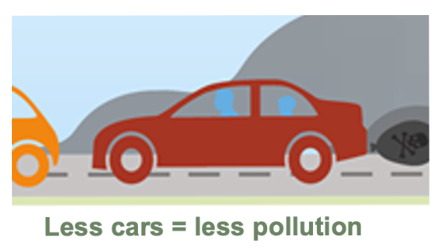

What is Air Quality?
Draw monkey – hand action
Play video - https://youtu.be/IyMxLloouF8 - 0:50-2:23

Slide 3
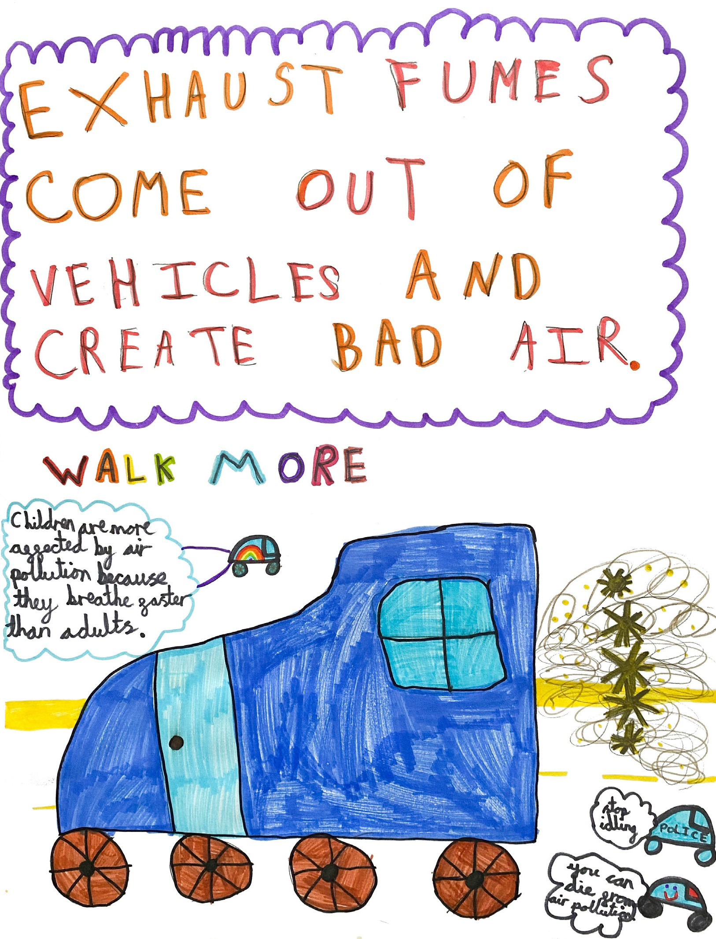







Where does air pollution come from?

Slide 4
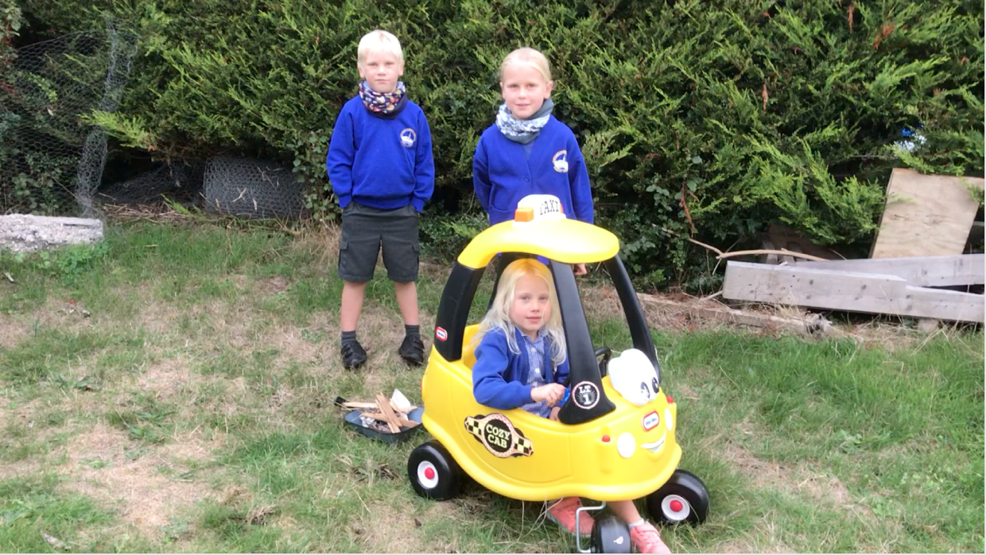
Play video - https://youtu.be/IyMxLloouF8 - 2:55-3:45

Slide 5
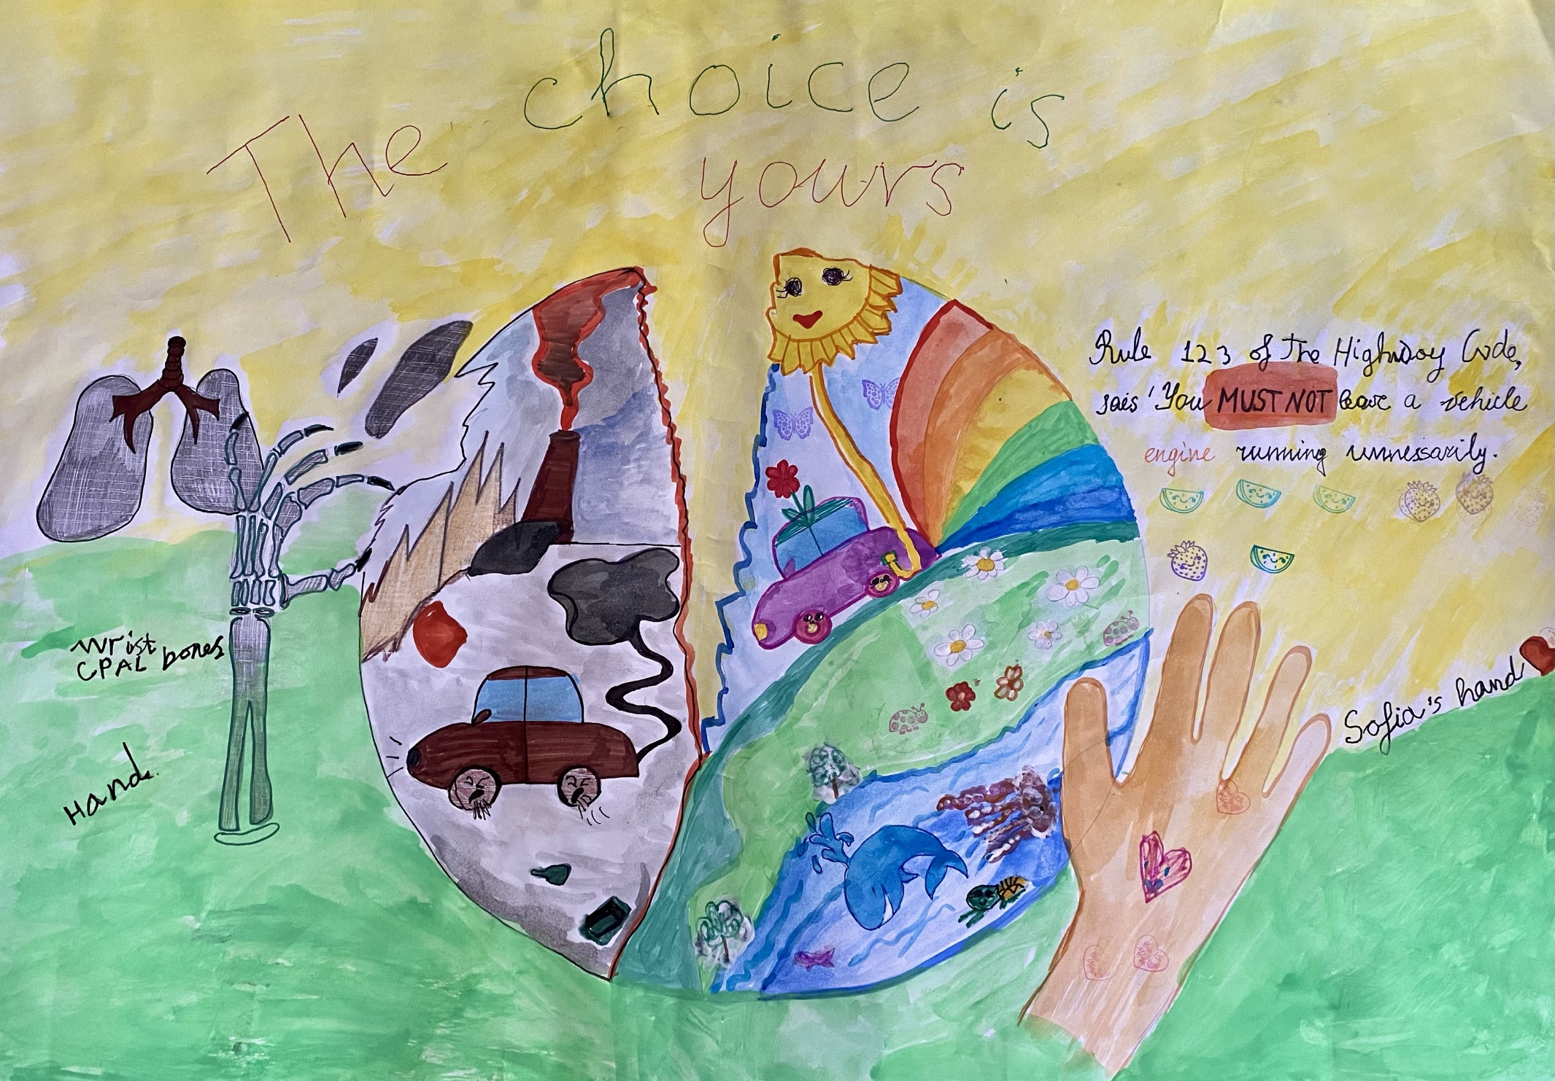
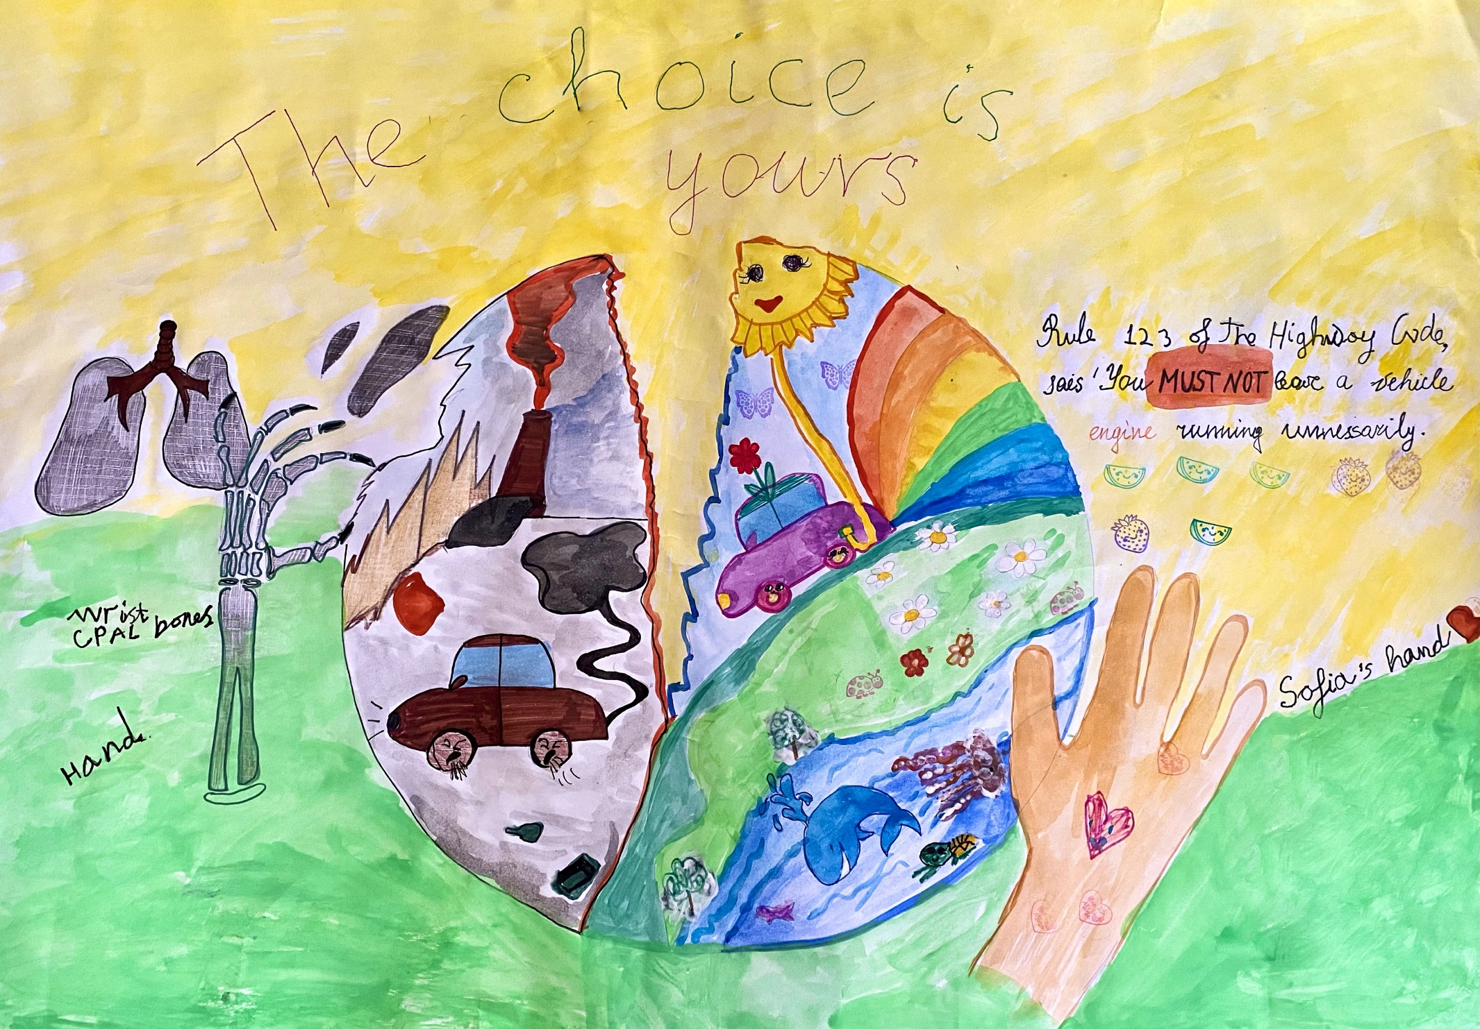


What is idling?
Idling is when a car engine is left running when the car has stopped.

Slide 6

One car =
25 Balloons in 10 seconds
Which is 25 x 6 =
150 balloons of toxic
gases per minute

Slide 7
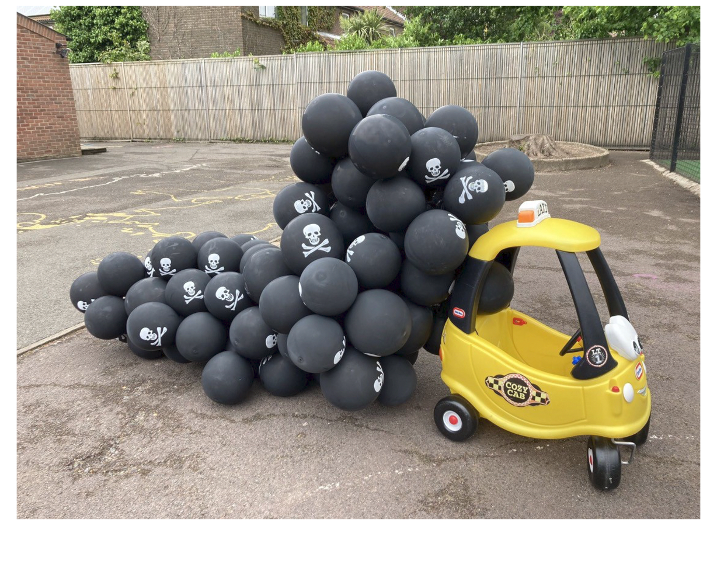

Slide 8

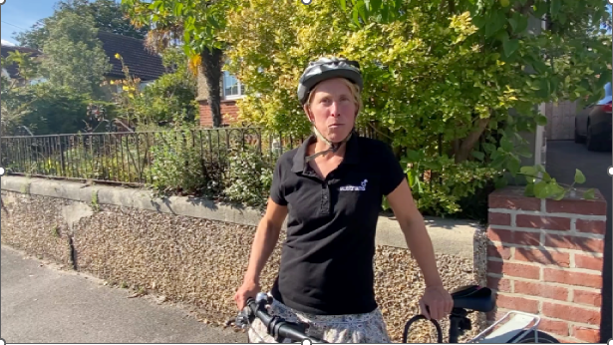

What can we do to make the
air we breathe cleaner?
Less pollution = less dangerous = healthier bodies
PARK AND STRIDE
CHOOSE ACTIVE TRAVEL
Play video - https://youtu.be/IyMxLloouF8 - 5:10 - 5:55
DON’T IDLE

Slide 9


Thank you
Any questions?
Sustrans is the charity making it easier for
people to walk and cycle.
We connect people and places, create liveable neighbourhoods, transform the school run and deliver a happier healthier
commute.
Join us on our journey.
www.sustrans.org.uk

