Slide 1

Presentation title
Subtitle, presenter name or date

Slide 2
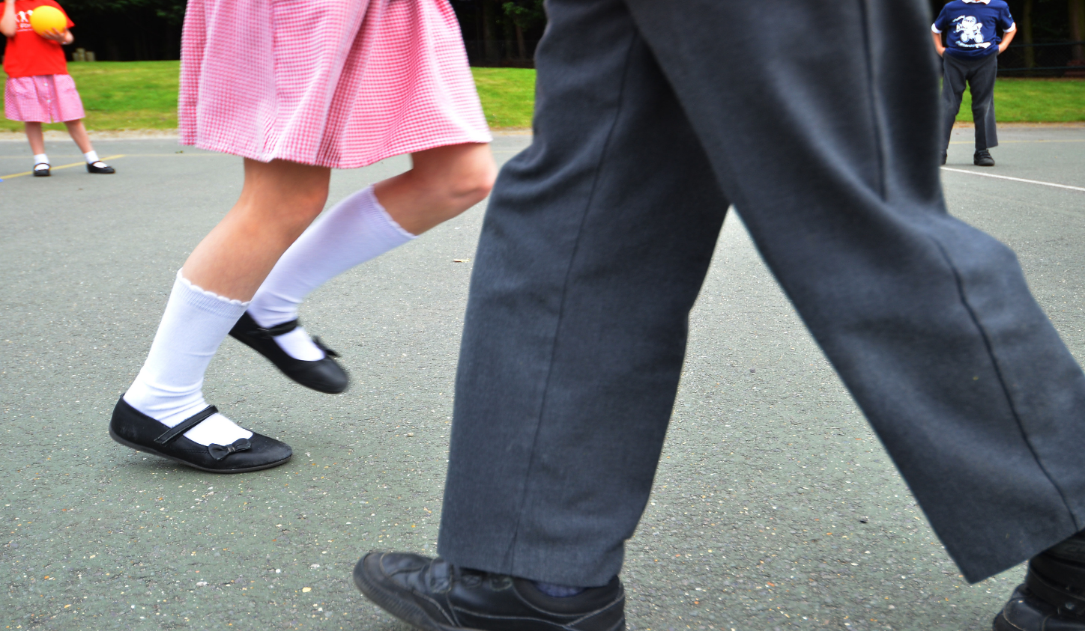

Vote with your feet
Notes:
Lesson 1: Value lines
We start lesson one with a quick activation activity to get pupils out of their seats and voting with their feet. It helps set the tone of the sessions and allows you to estimate how the pupils are going to deal with the ideas and concepts later on.
You ask the pupils a series of questions and they answer by standing somewhere on the line between strongly agree and strongly disagree. Once they are in place, you can ask a few pupils why they have made their choices and ask other pupils if they share the same views. Early on you will see patterns emerging with regards to travel patterns, attitudes and feelings to the area they live in.

Slide 3

How do you get to school?
Notes:
*For KS3 this is the last slide of lesson one.
The purpose of this activity is to get pupils thinking about their environment.

Slide 4
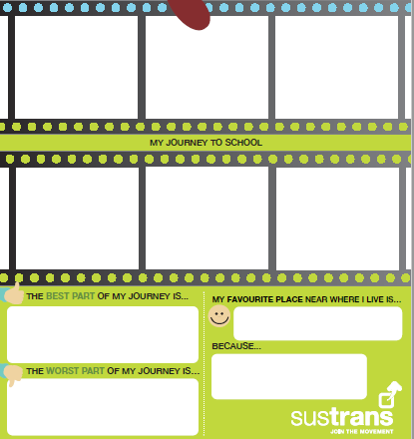


In your pupil booklet, draw your house in the top left corner and your school in the bottom right
Big Street Survey | 08 January 2020
Notes:
*For KS3 this is the last slide of lesson one.
The first task is to draw a six-part cartoon of their journey to school, showing the everyday landmarks that they use to highlight their daily journeys to school. Older pupils will want to try and give you the right answer, but there is no right answer, the more they flow through it and draw what immediately comes into their minds the better.

Slide 5

In the film-strip squares between them, draw pictures that shows your journey to school (what do you see, what landmarks are there?)
Big Street Survey | 08 January 2020

Slide 6
Put a smiley or sad face representing how you feel about each of the pictures in each of the film-strip squares
Big Street Survey | 08 January 2020

Slide 7
Complete the boxes at the bottom
Big Street Survey | 08 January 2020
Notes:
What you will find is that….
Pupils who walk will have lots of detail in their pictures; people, animals, flowers, speech bubbles, it will usually tell a good story of their journey.
Pupils who are driven will usually have less detail, they will have a couple of big landmarks such as shops, petrol stations and sometimes friends’ houses etc. They will often struggle to know how long or how far their journey is.
Pupils who ride will often have something between the two depending on how busy the route is. Thinking more like a pedestrian on quiet routes and more like a driver on busier ones.
It’s good to pull out a few examples and get the pupils to share their experiences. Do they see a pattern forming in each modal group? What are the common themes and issues?
Next ask the pupils to score all six drawings with a smiley or sad face and ask for a show of hands to see how many smiley’s they have in total. It’s rare to have five or six!
Once you have found out all the scores, ask the pupils if they would like it if their journeys could be all smiley faces?
Now is their chance to try and change this…..

Slide 8
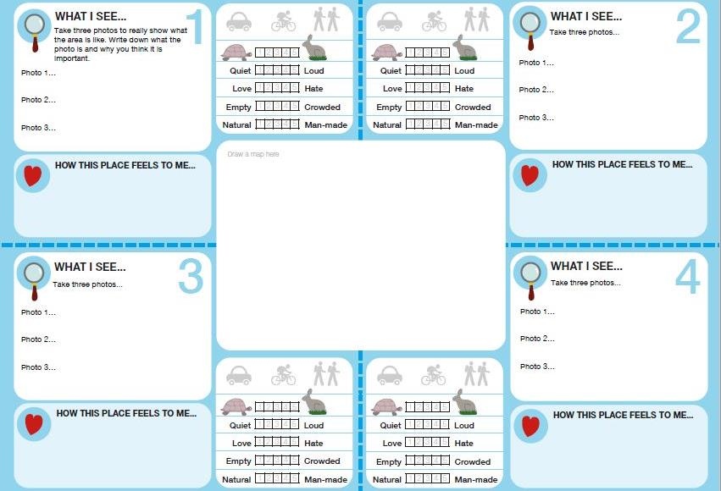



N
Notes:
TEACHER NOTES: You could place a map of your own area in the centre here or link this one to Google Maps and search for the local area. It is helpful to do a simple sketch map of your area, either on an interactive white board or on a large sheet of flipchart paper so that pupils can copy it.
However, before you head out to do some fieldwork, it’s good to make sure that all pupils understand the work that they will be doing outside of school, it gives better results and allows pupils to be a little more autonomous too.
Start by drawing a sketch map of the area around the school. It’s a useful geographical skill, but it also allows you to tailor the map to your needs giving the right amount of details for the work you are doing. It is even better if you can get the pupils to help draw the map.

Slide 9

What do you see and feel?
Notes:
TEACHER NOTES: Let the next slides walk you through what the students need to be doing in the field.
It is important to get across that the photos for the “what I see” represents the quantity of what they see.
For the rest, it shows what and where they need to be entering their data at each site you visit.
Once it’s done, get the pupils to decide what are the most relevant places they would like to visit to complete the study and add them to the map.
Now its time to explain the work…

Slide 10
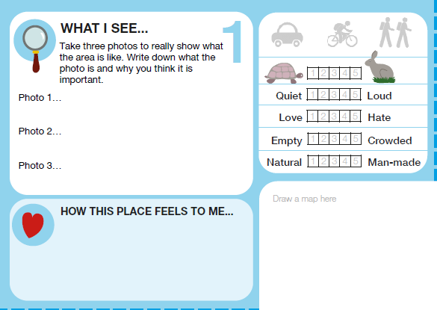
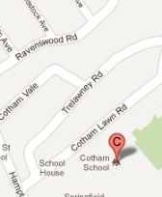
In ‘what I see’, take three photos which you think best represent the area that you are studying.
Then write a paragraph explaining why you took each photograph.
0
10
21
X
Very busy road, with cars parked on each side makes it very hard to cross the road
X
X
Lots of street trees make it feel like a healthier place to be
X
Cars parked on the pavement makes it hard to walk along safely and hard for those in wheelchairs
X
Big Street Survey | 08 January 2020
Notes:
The lesson plan has good detail on what you are recoding and how to get the best results. As much as possible you want the pupils to be able to view each site objectively, but creatively too, trying to look beyond what first meets the eye.
For the What I see section, pupils will take three photos. Then they will have to write down why to make them think a little bit harder about what they are choosing, and also for reference later on.

Slide 11
In ‘how I feel’, simply write a few words that sum up the area you are in, e.g. busy, exciting, quiet, green, messy, grey etc.
0
10
21
X
X
X
X
X
Happy
Fun
Safe
Big Street Survey | 08 January 2020
Notes:
For the How I feel section, encourage them to use quality and emotive words. Just remember that the weather needs to be discounted from their feelings as it changes pretty often!
Recording all the info is pretty straight forward, but it’s a good opportunity to have a chat about the fact that they are conducting a scientific study, reliable data and why its important!

Slide 12



Doing fieldwork safely
Make sure you have any medication you might need
Make sure you have sensible clothing for being outside
Stay with your group at all times
Only cross the road when instructed to do so
Big Street Survey | 08 January 2020
Notes:
Go through the safety briefing before you go out into the streets. This is usually best to follow the schools standard operating procedure and it’s a good chance to let pupils take the lead.

Slide 13
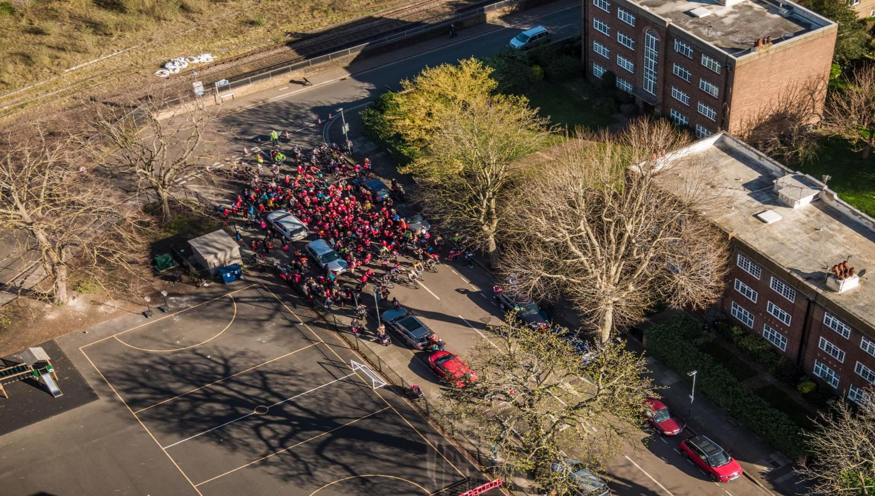
Notes:
*For KS3 this is the last slide for lesson 2.
Being out on the streets really brings the topic alive and it’s a great chance to reiterate things that you covered in the classroom. Just be careful not to lead the conversation too much. Also, sometimes is better to let the pupils absorb their environment and then move onto the discussion when you return to class.
Once you’re back in the classroom there may be time for a short plenary.
And, that’s the end of the first session.

Slide 14
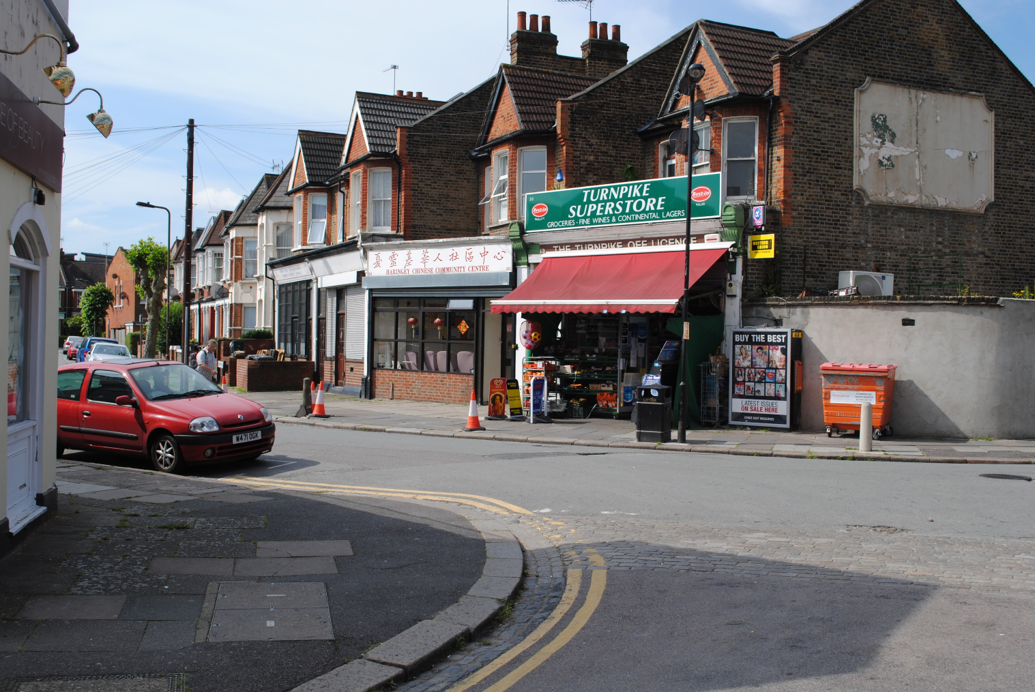
Spot the difference

Slide 15
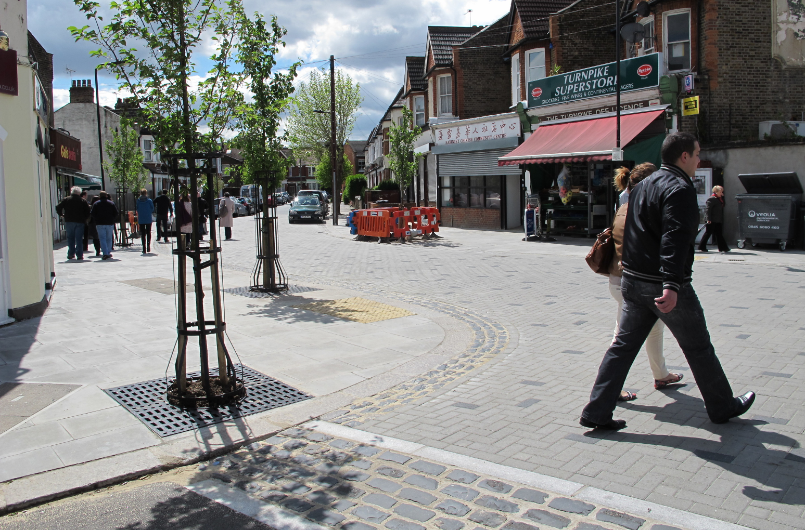
Spot the difference
Spot the difference

Slide 16

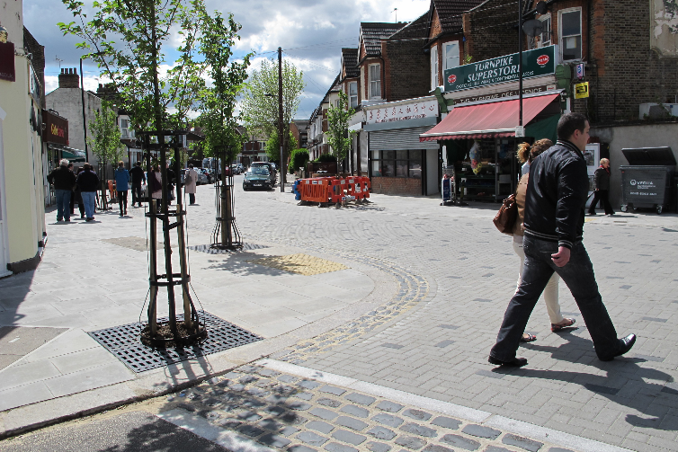
Spot the difference

Slide 17

Street Scenario
Street Scenario 1
You have a school in a wealthy suburban neighbourhood. There is a dead-end road leading to the school with pavements either side with a small grass verge. Lots of parents (and some residents) park on the verge/pavement when they come to drop their children off.
Parent 1: “I have a busy job and I need to be able to park quickly, so I often park on the verge on the narrow road close to school.”
Child 1: “I find it really scary when the cars, especially the 4x4’s, pull onto the path where I am walking.”
Child 2: “I find it really hard to cross the road between all the parked cars.”
Head teacher: “I have spoken to the parents who park on the verge, but they say it’s the safest way to drop off their kids. But parents walking say it’s dangerous! It’s really hard to keep everyone happy.”
Councillor: “The school has written to me about the problem, I really want to help, but don’t have any money to help with.”
As a group read the Street Scenario card and share out the roles between you.
Practice it a couple of times and then in turn, come and present it to the class.
You have five minutes for each scenario.
Notes:
Activity 6: Street Scenario
Until now, much of the lesson has been based around the pupil’s world view and their experiences in their local area.
The next activity focusses on getting a better idea of the context in which their situation fits and to see the constraints and opportunities that everyone has to deal with in order to achieve change.
The Street Scenarios provide pupils with six theoretical role plays to work through.
Split the class into table groups and give each table a role play they will then perform to the class.

Slide 18
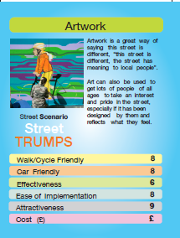
Street Scenario
Listen to the role play and then look at your Street Trump cards.
Decide which of the solutions are the best for each Street Scenario
Big Street Survey | 08 January 2020
Notes:
Ask the table groups to use the Street Trump cards to come up with their best 3-5 solutions. The solution should consider what is best for the environment and the people but, it is also very important that it is achievable with the budget available.
This activity is then repeated allowing each group, to provide a chance to perform their role plays.

Slide 19
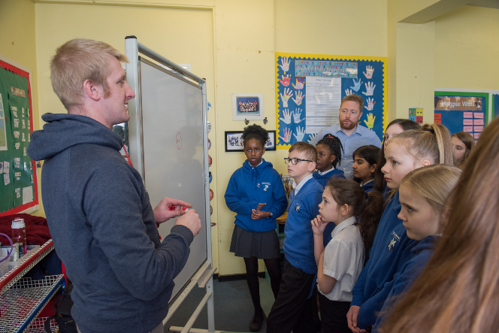
Street Scenario
Discuss and share the solutions you have come up with to the whole class.
Why do you think they will work?
Big Street Survey | 08 January 2020

Slide 20
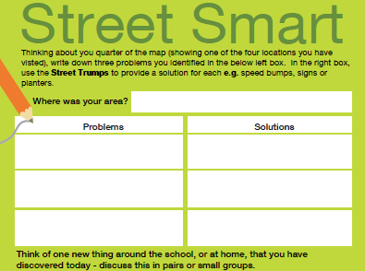
Our Street Scenario
Now you have seen a lot of problems that face schools across the country, what are the issues that affect your school?
Using the information and photos that you collected in the field, in the Street Smart section of your pupil booklet write down three problems that will form part of the School Scenario.
Now set about solving it!
Notes:
Now it’s time to start looking a little closer at the issues that affect the school by bringing together the perceptions the pupils have of the area and comparing them to the results that they found during the fieldwork.
Give each group of pupils one of the study areas you visited. Get them to look at the photos that were taken at that area and discuss the reasons why they took them. Do they see anything different when they look at the photos now? How do the words they chose to describe how they feel fit in with the photos? Do the vehicle counts and other information fit in with this?
Ask each group to write on the back of their sheets in the Street Smart section three things per area that they feel are problems.
Once everyone has done this, get each group to share the problems in each area and then record and compile it; this then forms the basis for the Schools Scenario…… Now it’s time to work out how to solve it!

Slide 21
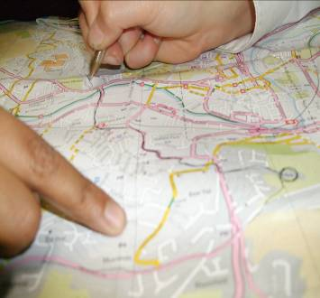
Map Action
On the maps on your table, draw on your three solutions.
Then add on any other ideas that would make the area a better place to live and travel.
Big Street Survey | 08 January 2020
Notes:
*Extension 7a:
If time permits, it’s good to give the pupils a map of the area around school and ask them to draw on them to show where and what changes they would like to make. These sketches can be neatened up and can form a really impactful part of a final display.

Slide 22
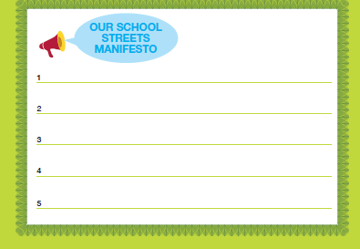
Class Manifesto
As a class, agree the five most important things that you would all like to change which would improve the area you live in.
Big Street Survey | 08 January 2020
Notes:
This is the chance to bring all of the excellent solutions that the pupils have come up with to the problems they found in the areas that you have visited.
Each group shared their three solutions which are compiled on the white board at the front of the class, similar solutions can be tallied up as you will often find themes appearing across all the groups.
Once you have your long list it is then time to vote on the classes favourite solutions to narrow it down to the five points for the manifesto. It is worth noting down the long list as there will still be a lot of good ideas.
Before you vote on the final five, it is worth revisiting the schools situation. What do they think can be practically done? Is there money available? What can be easily done by the pupils and the school?
Ideally you will have some manifesto points that can be easily enacted by the schools and the pupils. A couple of easy to implement initial changes can increase the pupils’ confidence and make them want to do more.
Now it’s time to vote on the favourites and find out what your manifesto is……!
We’d love to see them at Sustrans too, so please email them to education@sustrans.org.uk in whatever format you choose. It could be a jpeg of a banner you make, simply a Word document, a short video of pupils voicing it or perhaps a picture of you presenting it to your councillor, MP or local head of transport or education? Alternatively, send it to The Big Street Survey, Sustrans, 2 Cathedral Square, Bristol, BS1 5DD. We’ll be using them to call on policy-makers ourselves to make the changes that young people want to make their journeys to schools easier and safer by foot and bike.

