Slide 1
Session 4: Create
Places that are good for the planet and for people
Creating 20 minute neighbourhoods

Slide 2
Overview
Engage: Climate change, COP26, 20 min neighbourhoods
Explore: Go out into our local neighbourhood.
Evaluate: How does out local neighbourhood measure up?
Create
What would you like to see in your 20 minute neighbourhood?
Notes:
This is the 4th of four workshops, through which pupils will develop an understanding of why changing how we live can help tackle climate change, and learn about 20 minute neighbourhoods.
The four sessions are outlined in the slide:
Engage – learn about COP26, how we can create places that are good for the planet and for people
Explore – go out and explore your own 20 minute neighbourhood
Evaluate – think about how well your neighbourhood measures up; what was good and what could be better
Create – design a vision of a 20 minute neighbourhood

Slide 3
Your 20 minute neighbourhood vision
Task: Create a vision of a 20 minute neighbourhood
You can use whatever materials are available to you in any way you choose.
You could focus on a small aspect of your neighbourhood or look at the big picture.
Think about what you found in your local neighbourhood – what would you like to change?
Look back at the map you annotated last session. Could you use any of your ideas for improvement?

Slide 4
Your 20 minute neighbourhood vision
Task: Create a vision of a 20 minute neighbourhood
Some ideas;
Re-draw part of your neighbourhood map, showing where you would like more greenspaces or pedestrianised roads.
Focus on a specific street. What would you like to change?
Create something you would like to see in your neighbourhood. Maybe you want a youth club or better places to hang out.
Create a collage of ideas that could improve your neighbourhood.
See the next slides for some examples

Slide 5
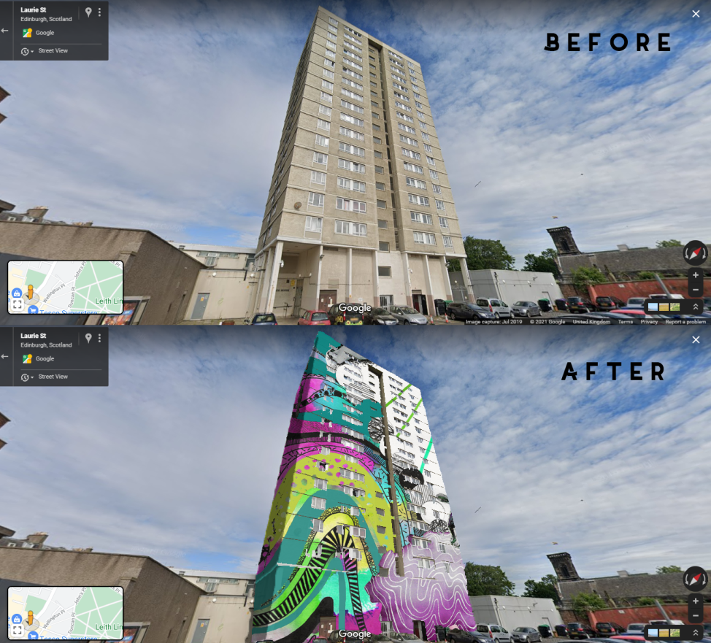
Example 1

Slide 6
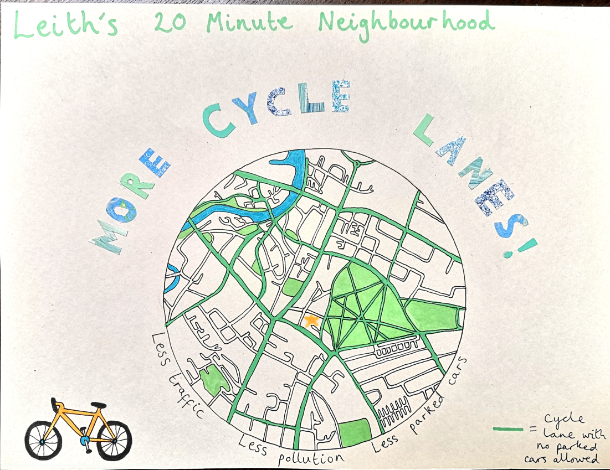
Example 2

Slide 7
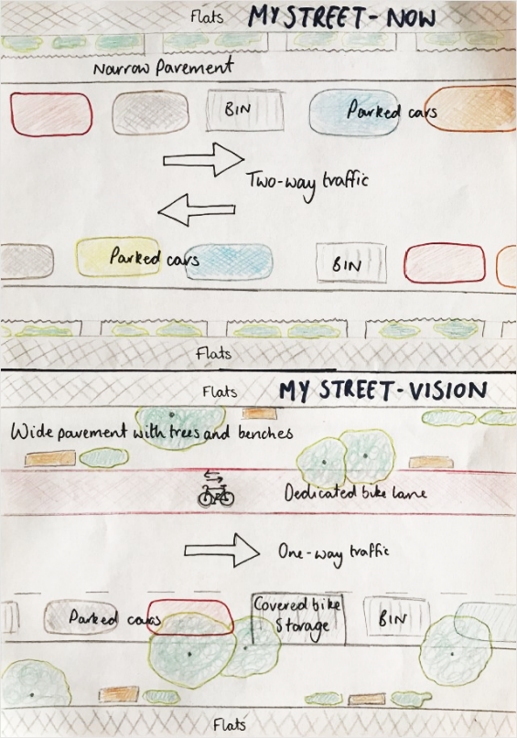
Example 3

Slide 8
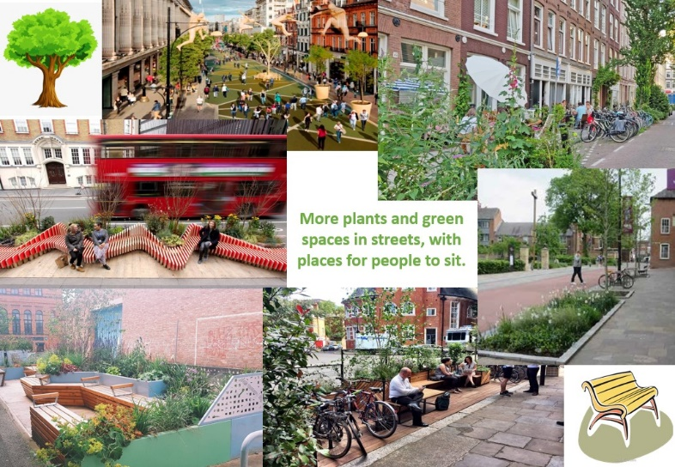
Example 4

Slide 9
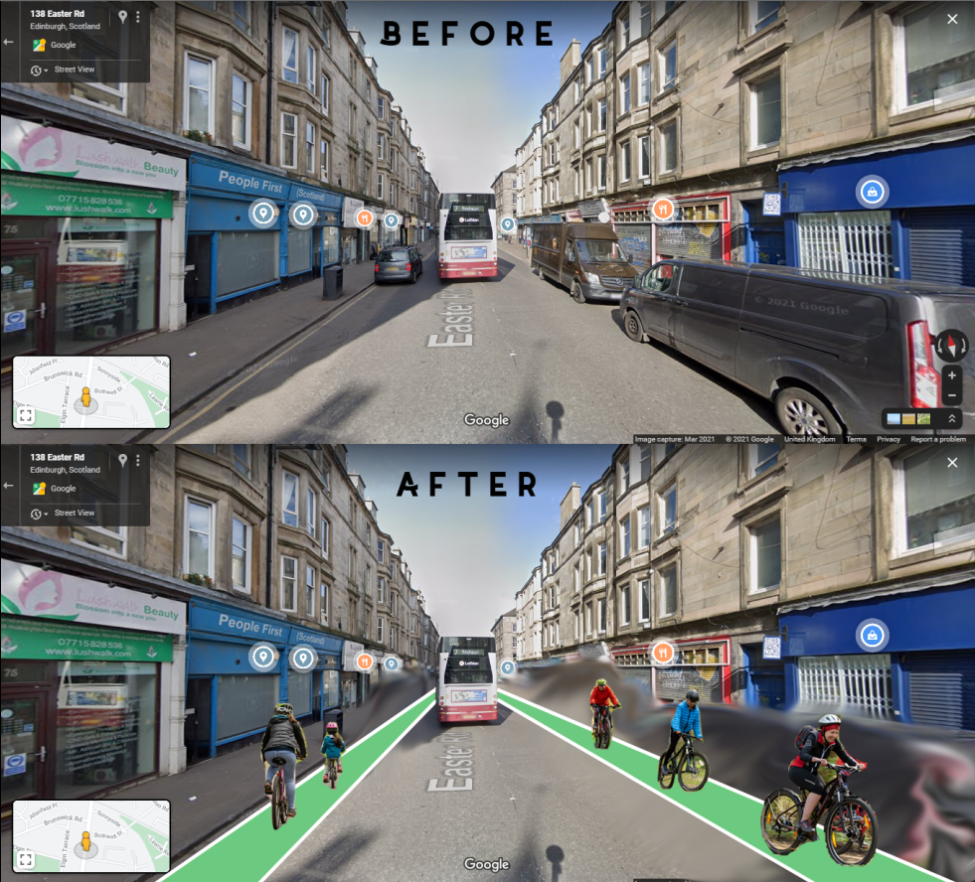
Example 5

Slide 10
All examples

